Slide 1

What affects the cost of a plane ticket?
Bianca Orozco

Slide 2
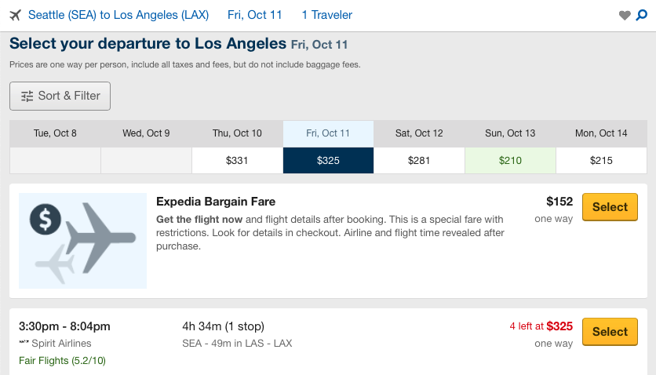
Seattle SEA
Los Angeles LAX
Fri, Oct. 11
Departure Airport
Arrival Airport
Flight Date
Departure Time
Arrival Time
Duration
Stops
Airline
Price
3:30pm
8:04pm
4h 34m
1 stop
Spirit Airlines
$325

Slide 3
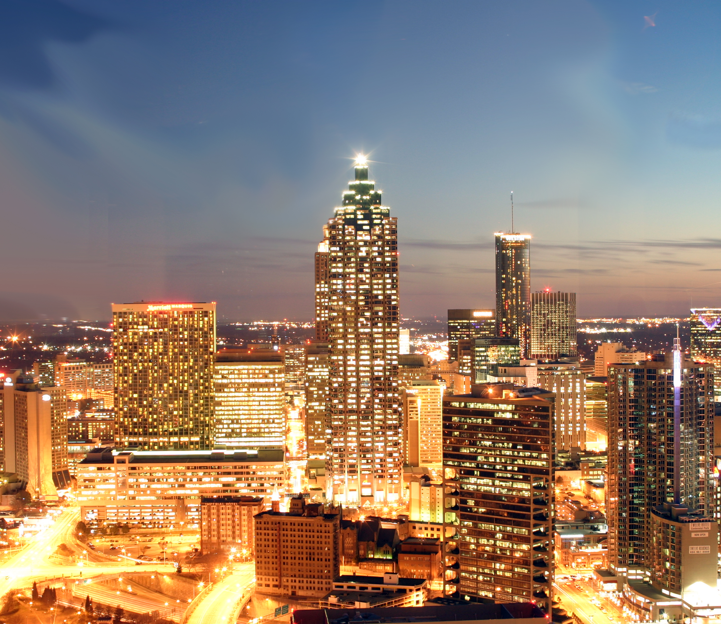
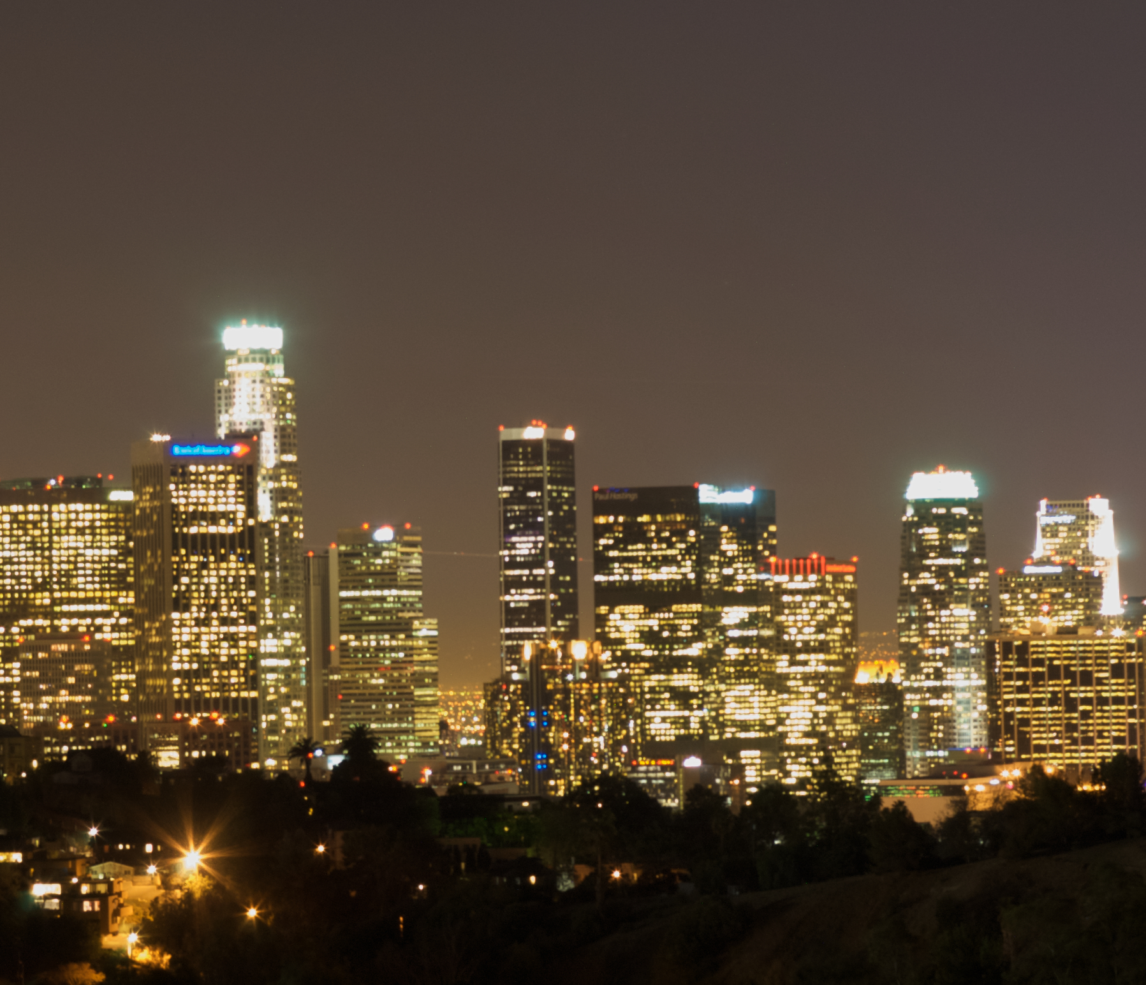
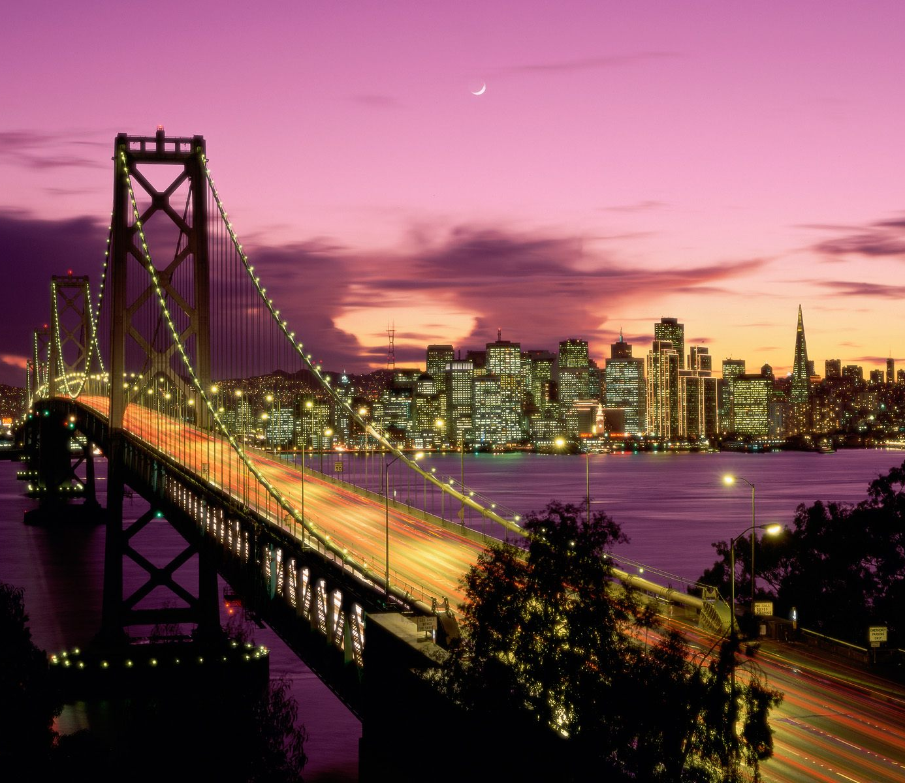
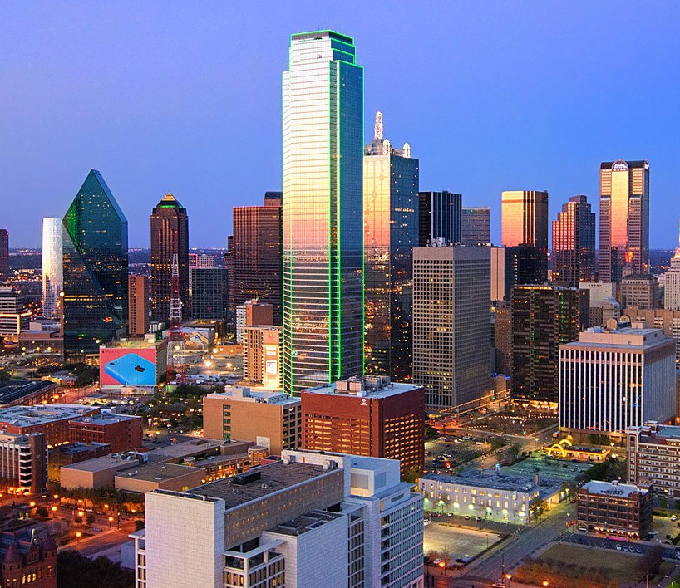
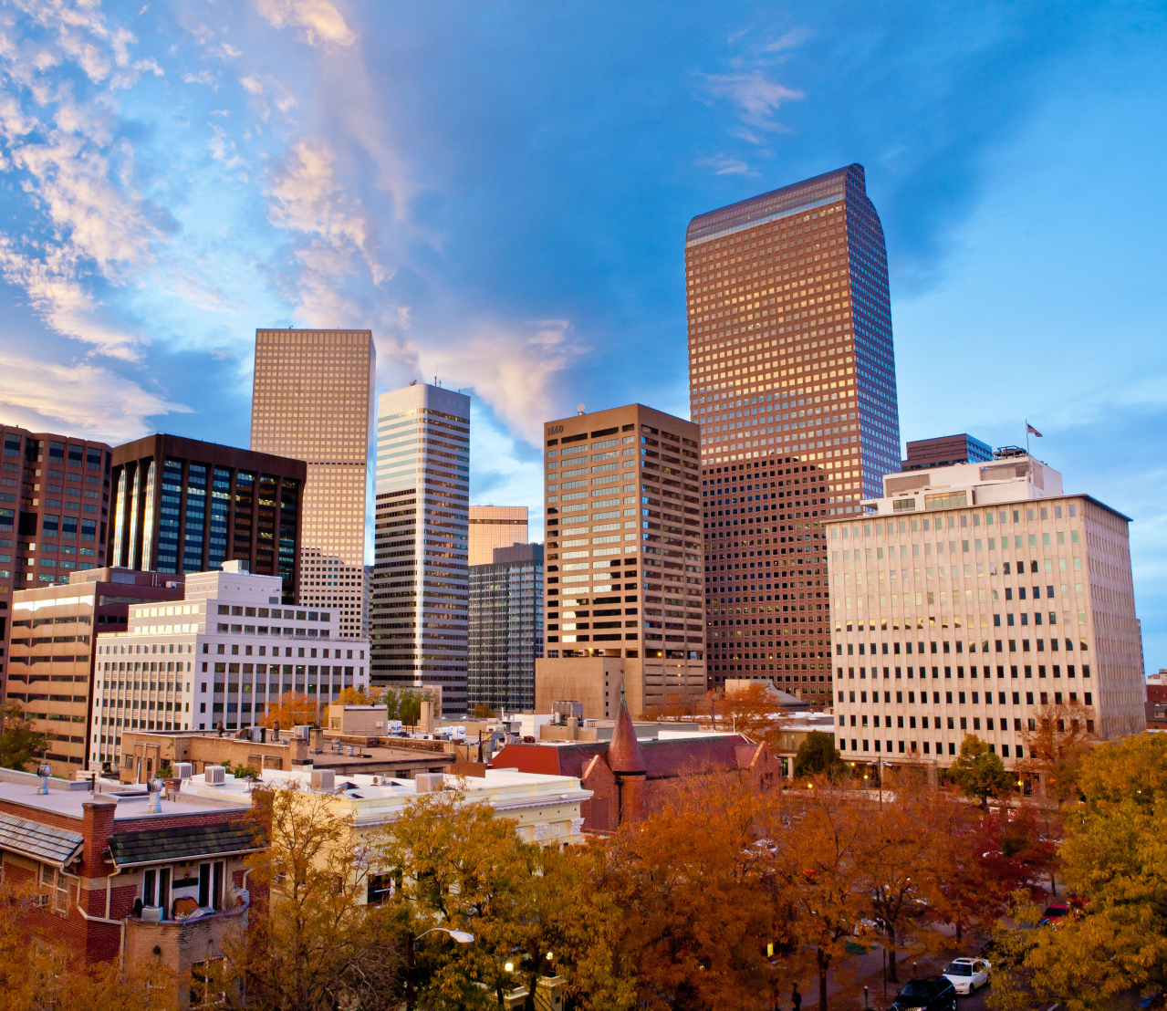
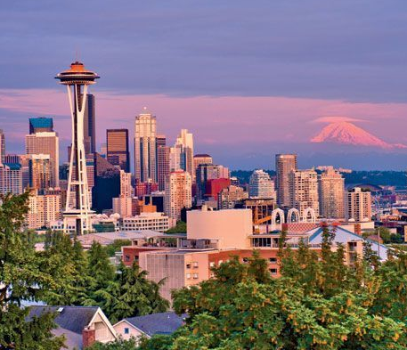
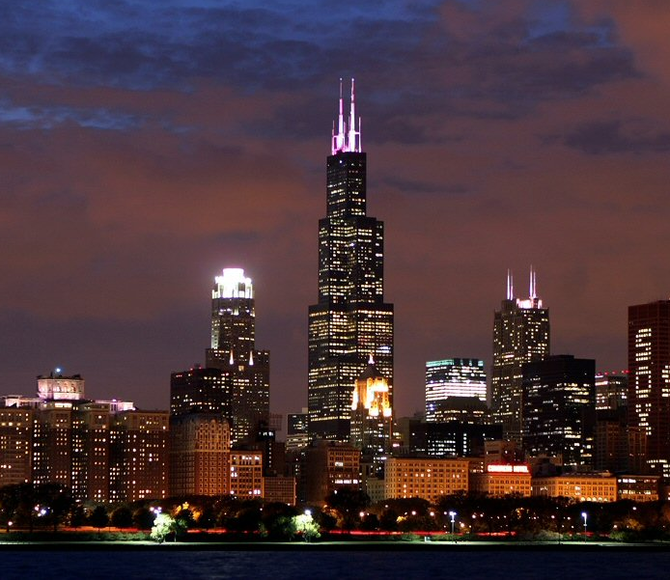
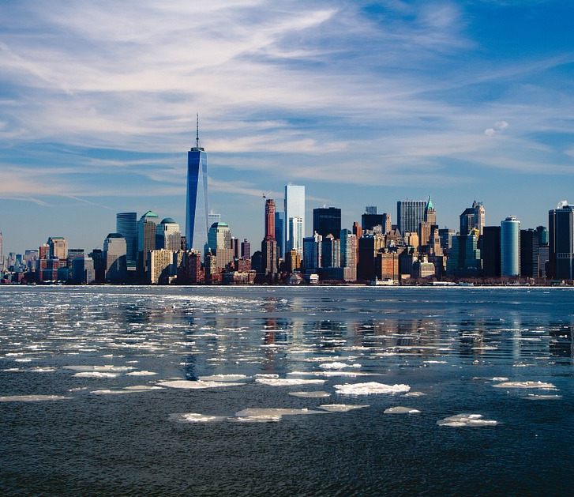
Atlanta
Los Angeles
San Francisco
Dallas
Denver
Seattle
Chicago
New York City

